Slide 1

Donkey And Smuggler optimization
S
D
O
Raheed Fadi & Khaled ahmad

Slide 2
Summary
What is the DSO algorithm?
How does DSO algorithm work?
Applications on DSO algorithm?

Slide 3


D
S
DSO algorithm: is a metaheuristic algorithm inspired by the movement and route selection behaviors of donkeys to find near-optimal solutions efficiently.
Some other algorithms might miss the best solution if it disappears during the search process
DSO algorithm address this issue by having two modes:
-Smuggler mode: finds the globally best solution.
-Donkey mode: maintains it or returns to it if it's lost.
The advantages of DSO over other algorithms its efficiency and ability to avoid getting stuck in local optima.
O

Slide 4
(Dso) algorithm Working process
Donkey mood:
The algorithm creates a bunch of virtual "donkeys" that explore the problem space. They try different solutions, some are successful others are leading to bad options.
the behaviors of donkeys can be concluded in the following points:
1.Run (Change path).
2.Face and support.
3.Face and suicide.
Smuggler mood:
Once the donkeys have explored enough, the algorithm analyzes all the paths they discovered. Then identifies the most efficient solution, like the shortest route or the one that minimizes a cost factor.

Slide 5






(Dso) algorithm Working process mathematically:
Smuggler mood:
Initializing the parameters of each solution.
Calculating the fitness value of each possible solution using:
$f\left(x_{i}\right)=\frac{\sum_{j=0}^{j}{x_{ij} + \prod_{j=0}^{j}{x_{ij}}}}{\sum_{z=0}^{z}{x_{iz} + \prod_{z=0}^{z}{x_{iz}}}}$
3. Choose the best solution and send the donkey.

Slide 6

(Dso) algorithm Working process mathematically:
donkey mood:
Choose the best solution, which has been defined by the Smuggler Mode.
Check if the Current Best Solution is better than the last one or not. If it is not Evaluate the Current Best Fitness Value.
If Current Best Soluthion is not Good:
Choose:
Run: re-evaluate the fitness of the possible solutions population and update the best solution.
Face and Suicide: Using the following formula, determine the second Best Solution that can be used as a Best Solution.
${best}_{Suicide Solution}=f\left(x_{i}\right)$ $\text{−}$ $f\left({best}_{Solution}\right)$
Face and Support: Use Second Best Solution to support the Best Solution.
${second best}_{Solution}=f\left({best}_{Solution}\right) \text{−} f\left(x_{i}\right)$
${best}_{Support Solution}={best}_{Solution}$ +${ second best}_{Solution}$

Slide 7
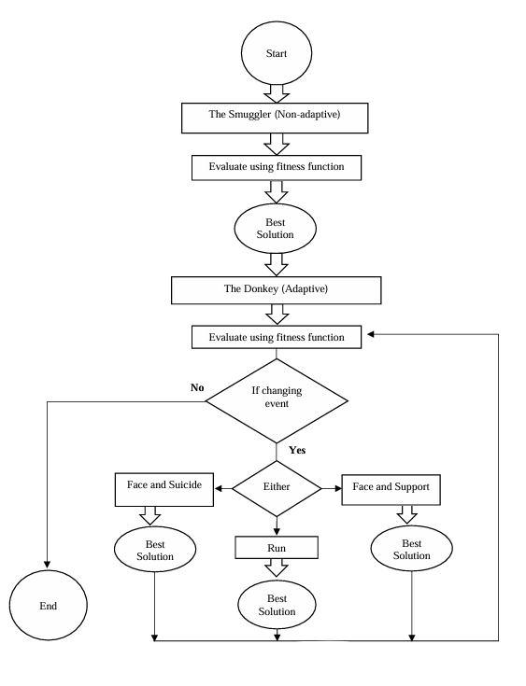
flowchart

Slide 8
Applications on (DSO) algorithm:
Traveling salesman problem (finding the shortest route to visit all cities).
Packet routing in networks.
Optimizing ambulance dispatch routes.

Slide 9

Thank you

